Slide 1
CPTS484 Presentation
By Young&Simple
Yuzhu Feng
Tianyu Miao
Lei Shang
12/05/2018

Slide 2
THEIA: Automated Guide for the blind

Slide 3
Intro of THEIA
THEIA is the automated system that helps blind people safely navigate indoors.
Usable for the blind
Extensible
Customizable
Notes:
extensible to accommodate the following typical variations: variations in interface, language, definitive needs of the user, new features, new sensors and hardware, etc. The system shall be customizable to every user: e.g. volume, the interval of instructions, etc.

Slide 4
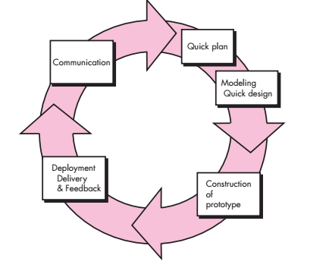
Development Process
Evolutionary Process Model: the Prototyping Model
Notes:
Have version updates

Slide 5
AS-IS TO-BE scenario

Slide 6
AS-IS TO-BE scenario 1
AS-IS: Although Jack cannot see, he wants to know what the nearby environment is like so that he can know what to do next. He has complained a lot about the inconvenience of shouting out aloud in order to get nearby people’s attention to help him.
TO-BE: THEIA enables the functionality of providing information of nearby environment: whether there’s a bathroom within 5 meters, whether there’s a drinking fountain within 3 meters, and etc.

Slide 7
AS-IS TO-BE scenario 2
AS-IS: Trudy is trying to go to a classroom. He needs to arrive there quickly because it is the time for class. However, he just know the destination without knowing the detailed route. He is hurried about looking for the classroom and wastes lots of time.
TO-BE: The app asks Trudy to give his current location and the destination. Then, the app calculates the distance of each route and recommends the shortest way to Trudy so that he can arrive the classroom on time.

Slide 8
AS-IS TO-BE scenario 3
AS-IS: Steve is trying to go to his next classroom. He knows he needs to walk ahead a few steps, and then turn left around the corner.However, he is not sure when to turn. He took a guess, but turned too early, hit the wall and hurt his head.
TO-BE: THEIA asks Stevie to give his current location and the destination. The app calculates the route from the current location to the destination. THEIA tells Stevie to “walk ahead 10 steps, then turn left”

Slide 9
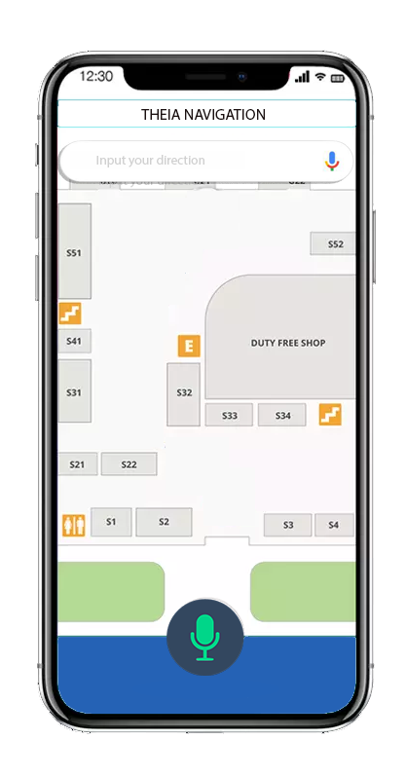
User Interface
Using voice to input and confirm the destination
The blind can able to use their voice to choice the most suitable path.

Slide 10
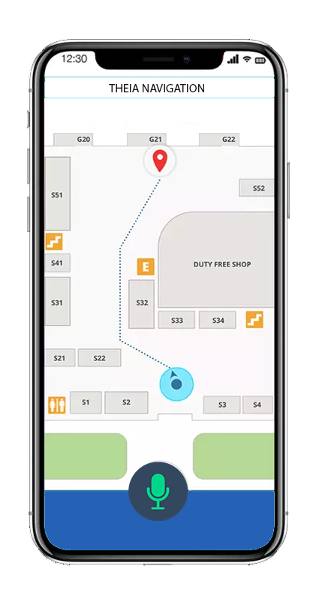
Routing interface
The route will be displayed on the screen, and at the same time there will be many voice prompts to help the blind direct the route and avoid obstacle

Slide 11
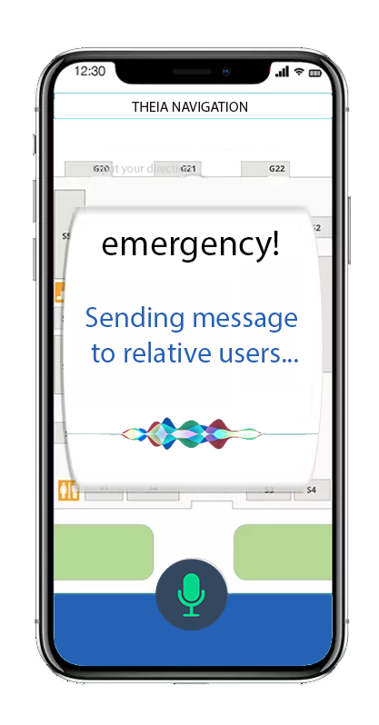
Emergency pop-up box
The blind can able to click 5 times power button to contact with relative users and agencies
The relative users will receive dangerous notice on their multi-functional devices

Slide 12
Functionalities
1.Multiple input: text & voice
2. Route Calculation: provide route choices: shortest, fastest, etc.
3. Real-time obstacle detection
4. Handy emergency handling
Notes:
Voice Input: definitely we need this functionality so that the blind people can use this app.
Handy emergency handling make it easy for the blind people who are in emergency situation to get firsthand help.

Slide 13
Advantages over conventional tools

Slide 14
Advantage 1: Security
We provide three ways which are from three angles to protect users safety.
1: the users
2: the guardians
3: the strangers(passerby)

Slide 15
the users
When they encounter some problems or accidents, they can click a button in the interface so that the situation can be known by their family members.

Slide 16
The guardians
A remote monitor locating the user’s position: when the user’s stayed in one place for a long time, the monitor will send a caution to their guardians who can then decide whether the users are safe or not.
Notes:
There is a remote monitor which can locate the users’ position. When the users’ stay in one place for a long time, the monitor will send an alarm to guardians. Then , they can send a message to the users. By choosing safe or not( voice notice), the guardians can know the cases of the users.

Slide 17
Advantage 2: Various route choices
1: shortest way
2: fastest way
3: safest way
4: uncrowded way

Slide 18
Route choices
Shortest way: Beneficial to people who don’t want to run a long way.
Fastest way: beneficial to people who want to arrive the destination quickly.
Safest way: Less steps or barriers: beneficial to people who prefer to take a smooth road; avoid encountering some problems or accidents.
Uncrowded way: Less people in this route; It might be convenient for blind people to run in this way.

Slide 19
Advantage 3: advantage over guide dogs
1: Better stability
2: Save money and time to train guide dogs
3: update maps or notices in time
4: security

Slide 20
Prototype Demo
UI, Functionalities

Slide 21
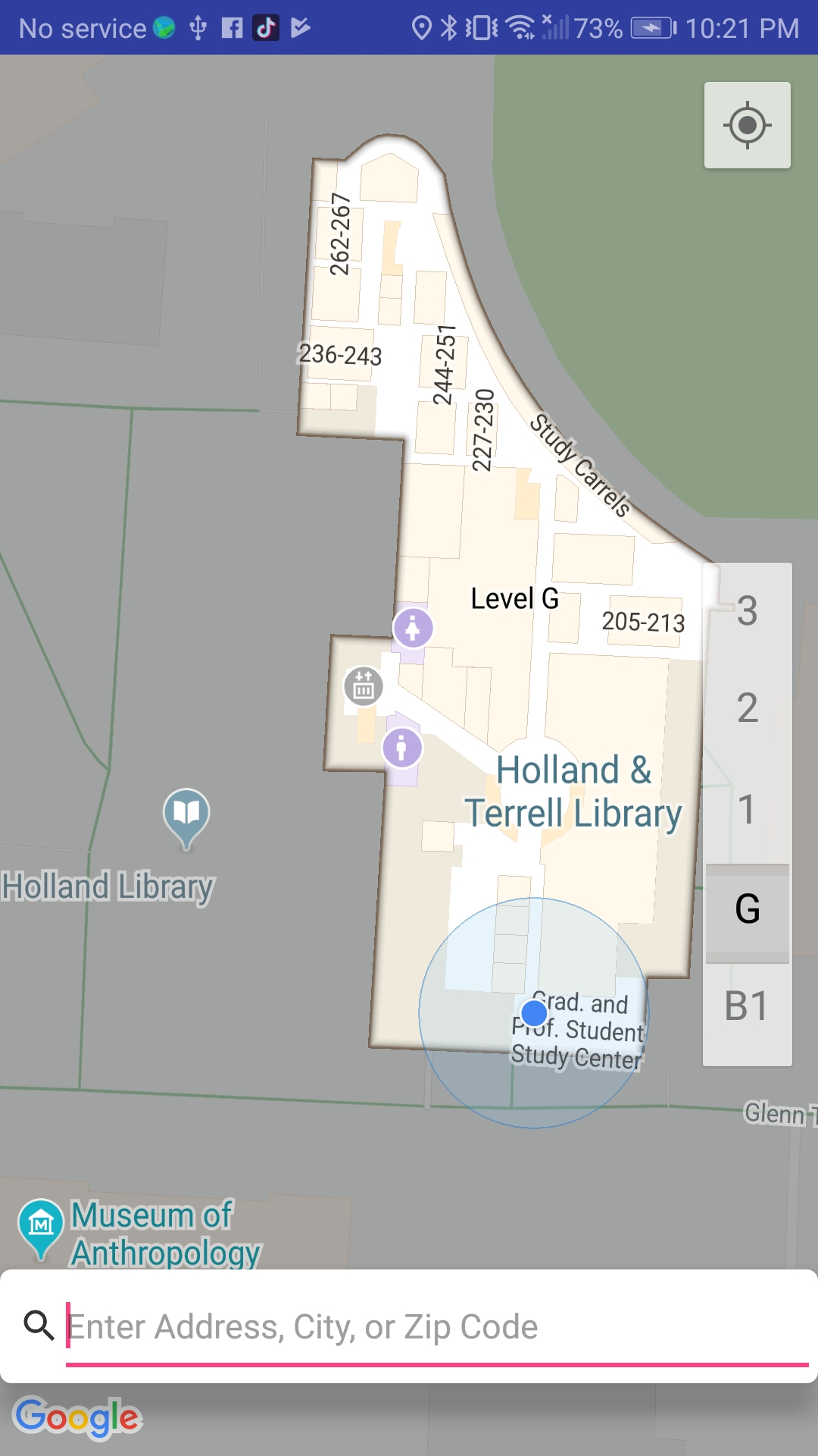

Slide 22
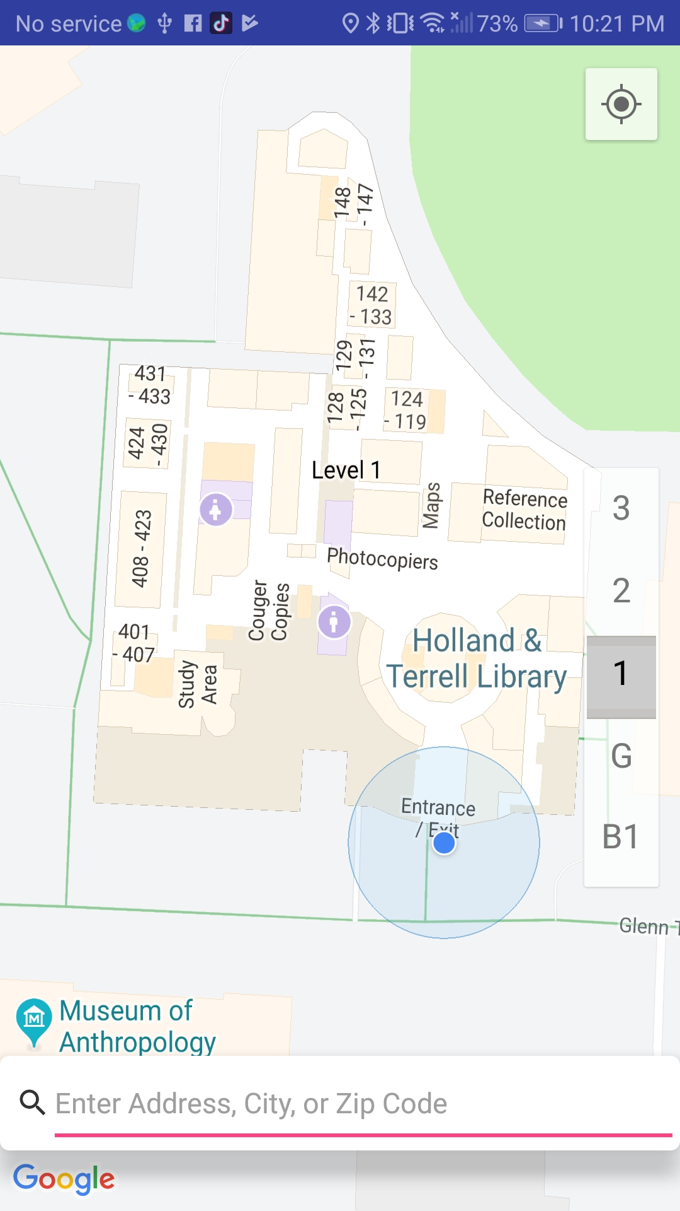

Slide 23
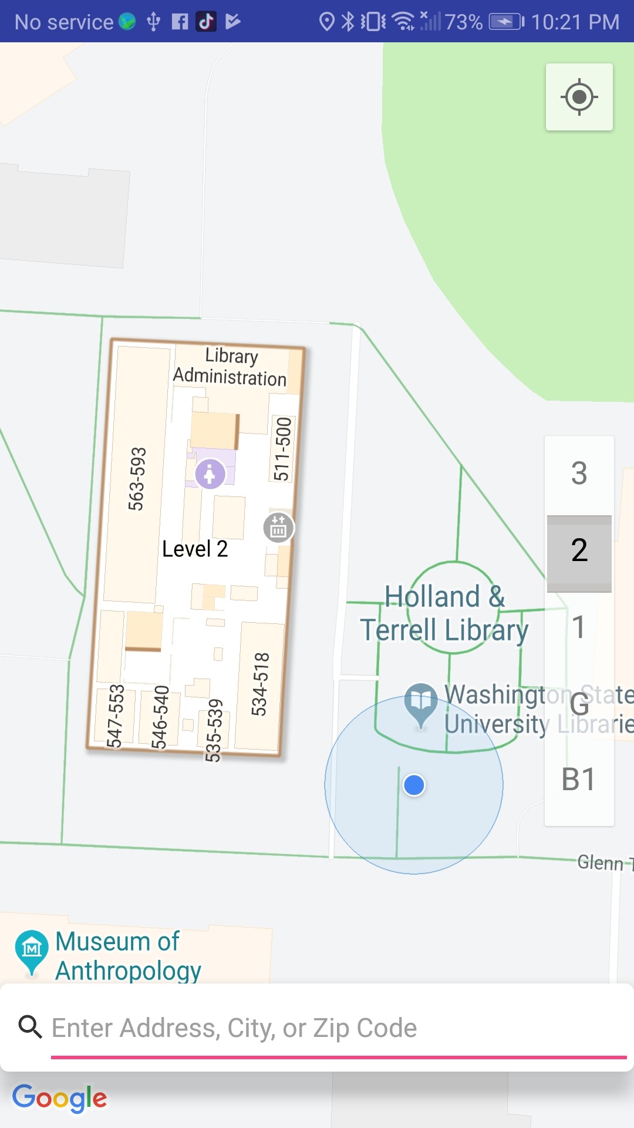

Slide 24
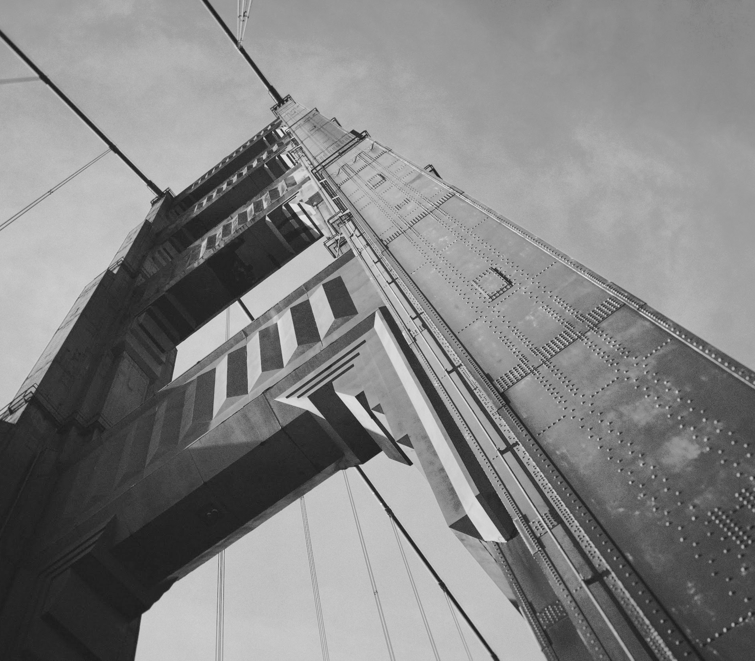
Thanks!

